Slide 1
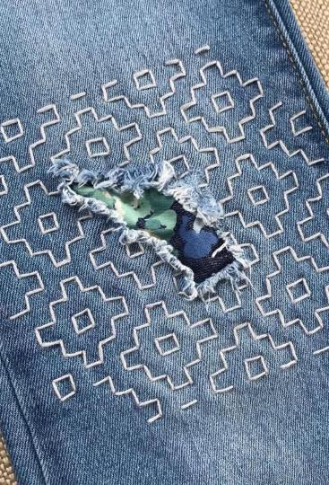
Visible
Mending

Slide 2
Connection to Craftivism
Sustainability of Environment
(from creation to distribution to landfill)
Anti-consumerism/materialism
Non-complicity in human rights violations

Slide 3
How did we get here?
Prior to mid 19th century, virtually all clothing was handmade at home or by a dressmaker/tailor (1)
According to Fashion United, the industry has a labor force of 3,384.1 million. Its value is equivalent to 3 trillion dollars. That means, it corresponds to 2% of the world’s Gross Domestic Product (GDP).
The Joint Economic Committee of The United States released a survey in 2019 affirming that, only in the US, consumers spent nearly $380 billion on apparel and footwear (2)

Slide 4
How did we get here?
The main goal of fast fashion giants is all about lowering production costs. This is why they violate workers’ rights and neglect the sustainability aspect of production. (3)
Clothing production is the third biggest manufacturing industry after the automotive and technology industries. Textile production contributes more to climate change than international aviation and shipping combined” (House of Common Environmental Audit Committee, 2019)

Slide 5
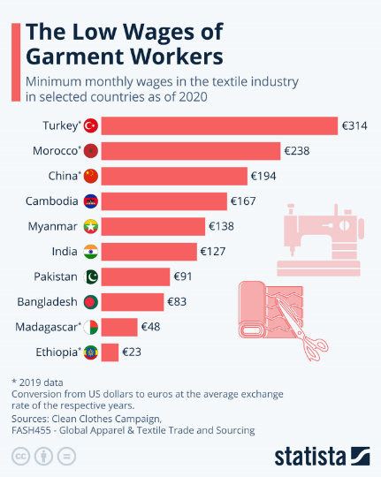
93% of brands surveyed by the Fashion Checker aren’t paying garment workers a living wage (Fashion Checker, 2020)

Slide 6
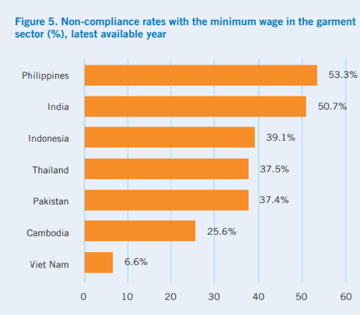
“Emerging markets take the biggest hit from the industry of fast fashion” (Changing Markets, 2019)
(4)
Fast fashion retailers save billions of dollars by locating their factories in emerging countries. The high cost of a large fashion industry in countries like India, Bangladesh, Pakistan, Cambodia and many more is the impact on the local environment and workers’ rights violations.

Slide 7
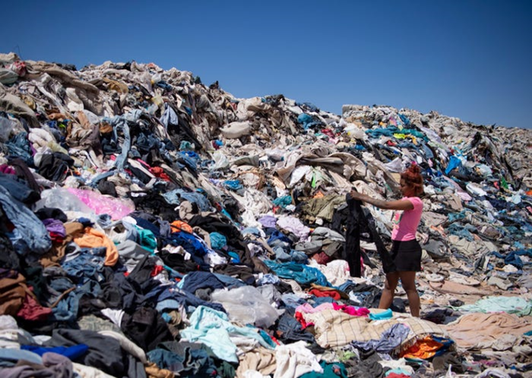
Fashion is ranked as the second most polluting business in the world by the United Nations Conference on Trade and Development,
right behind the oil industry
The average American throws away around 81 pounds of clothing yearly” (Saturday Evening Post, 2018)
A woman searches for clothing amid tons of garments discarded in the Atacama desert, in Alto Hospicio, Chile. Martin Bernetti/AFP via Getty Images

Slide 8
The number of wears an item of clothing receives before being discarded has reduced by more than a third since 15 years ago, according to market experts Euromonitor International.
“One in three young women, the biggest segment of consumers, consider garments worn once or twice to be old” (The Guardian, 2019)

Slide 9
Before you buy
Check Apps
Clean your closets!
Wait?!
Good On You
FairFashion
Rank a Brand
ILAB (Sweat & Toil, Comply Chain)
Gratitude

Slide 10
What can you do with unwanted/discards?
Host or attend a clothing swap
Offer friends
Donate
Mend, Repurpose & Upcycle
(e.g. turn pants into shorts, skirt, bag, shirts into tanks, cosplay, etc)
Repurpose & Create
(scrappy quilts, t-shirt quilts, t-shirt yarn, dog toys, padding, bath mats, archery targets, use as rags)
Mend & Rewear
Donate
Great Condition
Good
Okay
Deplorable

Slide 11
Sources
https://www.britannica.com/art/fashion-industry
https://fashinnovation.nyc/fashion-industry-statistics/
https://goodonyou.eco/fast-fashion-facts/
https://www.ilo.org/wcmsp5/groups/public/---asia/---ro-bangkok/documents/publication/wcms_534289.pdf

Slide 12
Let’s get started.

Slide 13
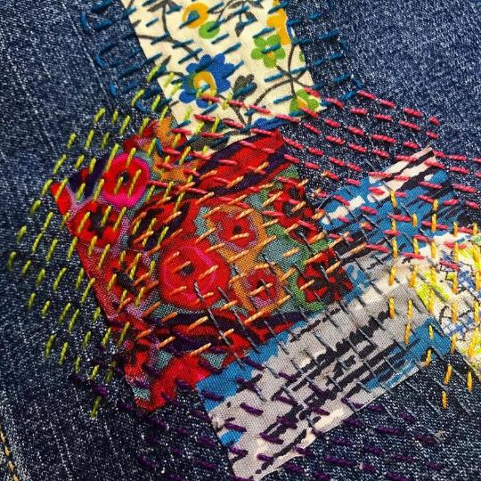
What is visible mending?
Visible mending is a style of clothing repair where your fixes, patches, etc. are apparent. It’s a fun way to extend the life of your clothing while showing off your work.

Slide 14
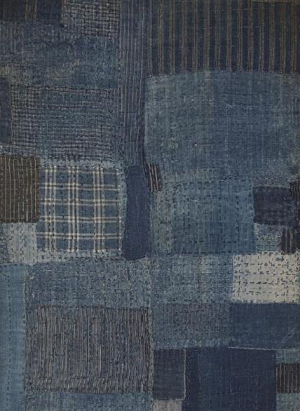
Sashiko and Boro
Sashiko (which translates to “little stabs”) and boro (derived from boroboro “something tattered or repaired”) are forms of visible mending that date back to the Edo period of Japan. It was a way for the working class to not only extend the life of their clothing and upcycle worn clothing, but also a way to add a decorative element to everyday items. Sashiko is a cultural and historical practice that many people engage in today.
Both of these methods have inspired modern day sewists.
Notes:
Sashiko is a form of stitching, a process of needlework. The Boro is the result of continuous & ultimate repetition of Sashiko.
One of the reasons sashiko designs have risen in popularity are because of their ease of use - the running stitch is easy to do and with patience and a steady hand, one can easily adapt sashiko designs into their sewing work.

Slide 15
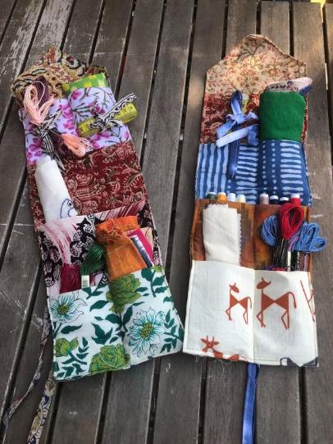
What you need to get started
Sewing needles
Thread (cotton, sashiko, embroidery, wool)
Patches (cotton, linen, and denim)
Pins
Fabric scissors
Optional: a thread waxer, needle threader, specialty needles (sashiko, darning, embroidery), ruler, water soluble marking pen or chalk, darning egg, thimbles

Slide 16
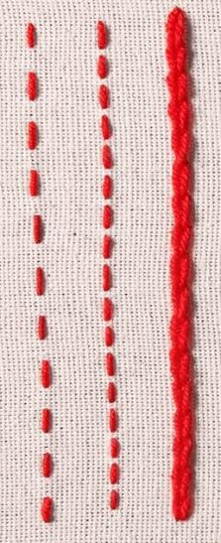
Basic stitches
Running
Backstitch
Whip
Most common stitch you’ll use.
Creates a continuous line.
Finishes raw edges on holes.

Slide 17
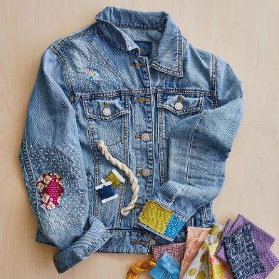
Working with patches
Decide if you
want your patch on the inside or the outside
Clean up the hole
with a pair of scissors and center the patch. Pin patch in place or use a basting stitch to temporarily sew it on.
Use a combination
of stitches to adhere the patch.

Slide 18
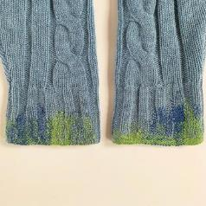
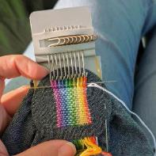
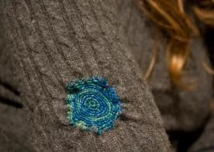
Other mending methods
Darning
Weaving into the fabric by hand to fix a hole/tear - great for knitwear (socks, sweaters, etc)
Speedweve
Like darning, but using a small loom to facilitate the weaving of a patch. Can be used on anything.
Crochet
Using crochet techniques to make a patch for your clothing - again, great for knitwear.

Slide 19
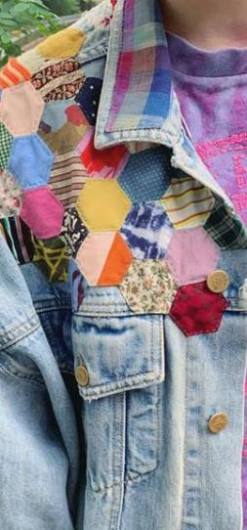
Tips for visible mending
Embrace your mistakes
Have a mending pile
Keep all your mending together and in sight.
If your patch is wonky, your stitches aren’t straight, it’s ok!
Keep it loose
Practice!
Don’t pull too tight on your stitches - doing so could pucker or warp your clothing.
The best way to improve is to keep fixing things and trying out new ideas.

Slide 20
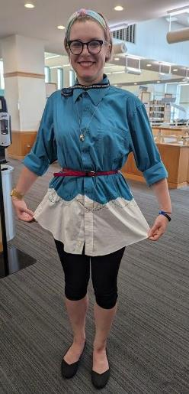
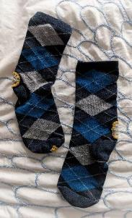
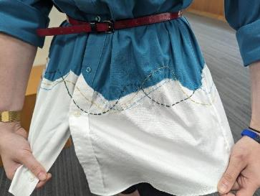
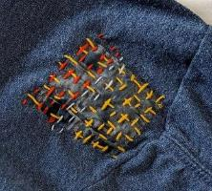
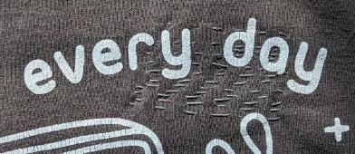

Slide 21
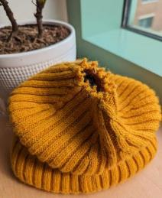
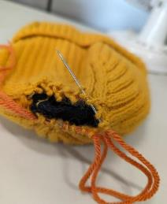
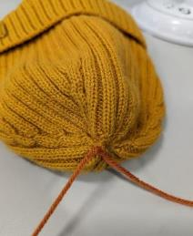
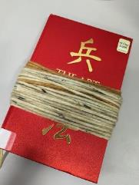
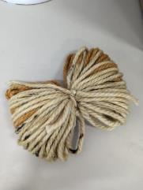
Fixing a hat and making a pom pom:

Slide 22
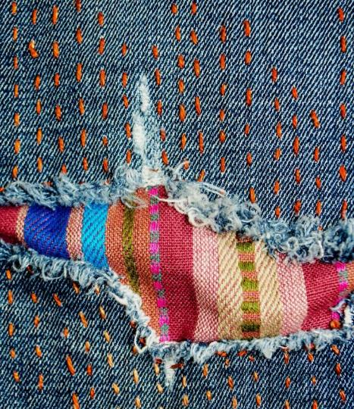
Library Resources
Books
Mending Matters by Katrina Rodabaugh
Consumed: On Colonialism, Climate Change, Consumerism, and the Need for Collective Change by Aja Barber
CreativeBug
How to Mend Clothing
Sashiko Sewing
Udemy
Sewing 101
Universal Class
Sewing 101

Slide 23
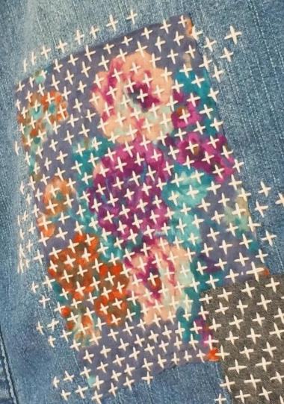
Thanks!
Questions?
adittmeier@dppl.org

