Slide 1
Upcycling your t-shirt
November 8, 2023

Slide 2
Why not donate?
Notes:
I’ll talk a little about why donating is not the ideal solution or first place you should go.

Slide 3
Why not donate?
Donation is a valid and often helpful option, but doesn’t have to be the first or only plan.
Lengthen the life of your shirt before it goes to a thrift shop or dumpster.
tons of rejects and salvage: there is a cost to clothes that do not sell, or have to be re-trashed from the get go
“All this trash adds up to more than $1 million a year in a trash bill, and it’s been growing every year for the past five years,” Steeves told NPR [spokesperson for Vermont and New Hampshire Goodwills]. This figure only accounts for 30 stores in two states. The actual bill for donated garbage across the country is likely mind-boggling. 2021 NPR article
Seattle Goodwill spends nearly $3 million a year disposing of garbage, hazardous waste and unsellable items. (Steve Ringman / The Seattle Times)
Notes:
I’ll talk a little about why donating is not the ideal solution or first place you should go.

Slide 4
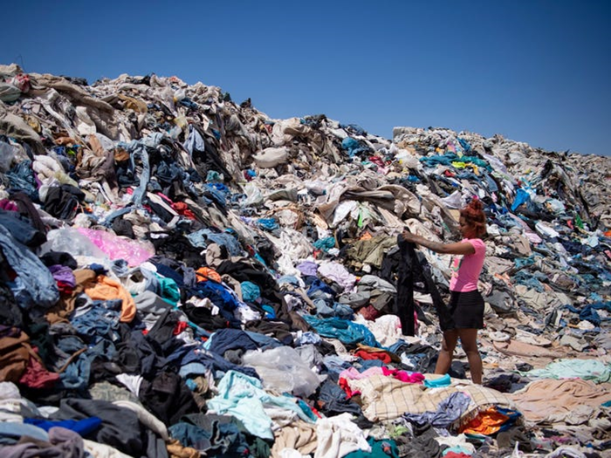
Notes:
I’ll talk a little about why donating is not the ideal solution or first place you should go.

Slide 5
Why not donate?
Clothes donated to third-world countries can harm local economies Most of the shipments are destined for Pakistan, Africa, and South and Central America
– 40% of these castoffs to Ghana end up as waste anyway.
– in 2018 Rwanda banned the import of secondhand clothing from other countries to protect its own textile industry from being decimated.
Notes:
I’ll talk a little about why donating is not the ideal solution or first place you should go.

Slide 6
Why not donate?
Clothes donated to third-world countries can harm local economies Most of the shipments are destined for Pakistan, Africa, and South and Central America
– 40% of these castoffs to Ghana end up as waste anyway.
– in 2018 Rwanda banned the import of secondhand clothing from other countries to protect its own textile industry from being decimated.
…and harm their bodies and land.
– While the clothes will break down eventually, their disintegration eventually leads to ‘…a poisonous clothing soup which spews toxins into the environment as the fibres break down
Notes:
I’ll talk a little about why donating is not the ideal solution or first place you should go.

Slide 7
Discards that are still in good condition can go to:
A thrift store.
Pros: easy, fast.
Buy/sell on online consignment sites such as thredUP or Poshmark
Pros: you get the $, you are buying and selling to a community that does not want to contribute to fast fashion waste/harm.
Cons: your own work and holding onto the item
Clothing Swap
Pros: people who want the items won’t have to pay for them, community building
Cons: harder to find or organize

Slide 8
Prevention is better than cure
Avoid buying clothes you don’t need
If it’s not an event of sentimental value down the road, think about opting out of getting the shirt.
That said, what to do with the shirts you already have?....

Slide 9
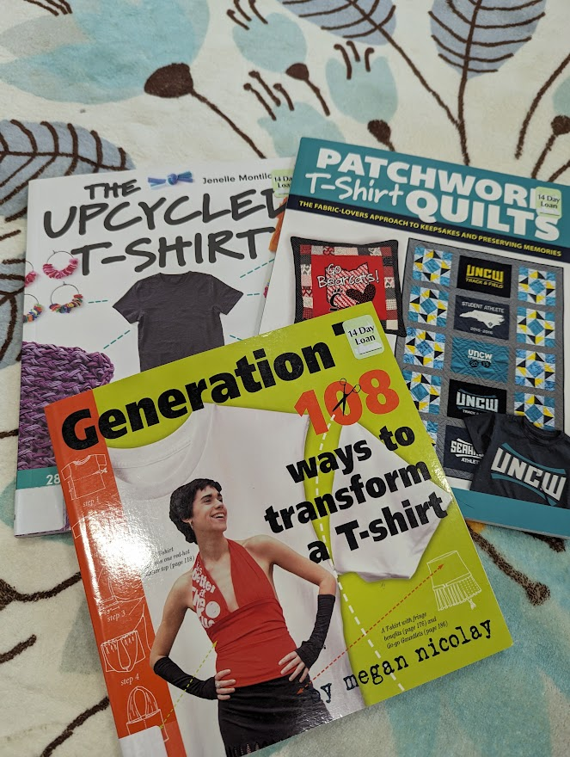
Things to do with t-shirts
Mend!
Modify/customize
Make into yardage to use instead of muslin or fat quarters, or drop cloth for projects (e.g. instead of a plastic tablecloth)
Use the fabric for other crafts (e.g. t-shirt yarn)
T-shirt quilt: a scrapbook that keeps you warm
Rags / stuffing / cotton

Slide 10
Modify your shirt
Into another shirt/top you like better can also add trimmings, buttons, beads, ribbons
Into other wearable item headbands, hairwraps, jewelry, costuming/cosplay
Nonwearable items tote bag, rug, bath mats, pet toys, stuffing, jewelry, flowers etc
Make t-shirt yarn for crochet, knitting, macrame, etc

Slide 11
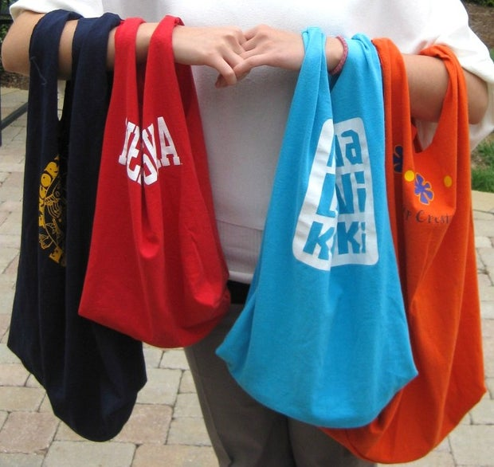
Make a Tote bag
Difficulty: Easy
Time: 5-15 minutes

Slide 12
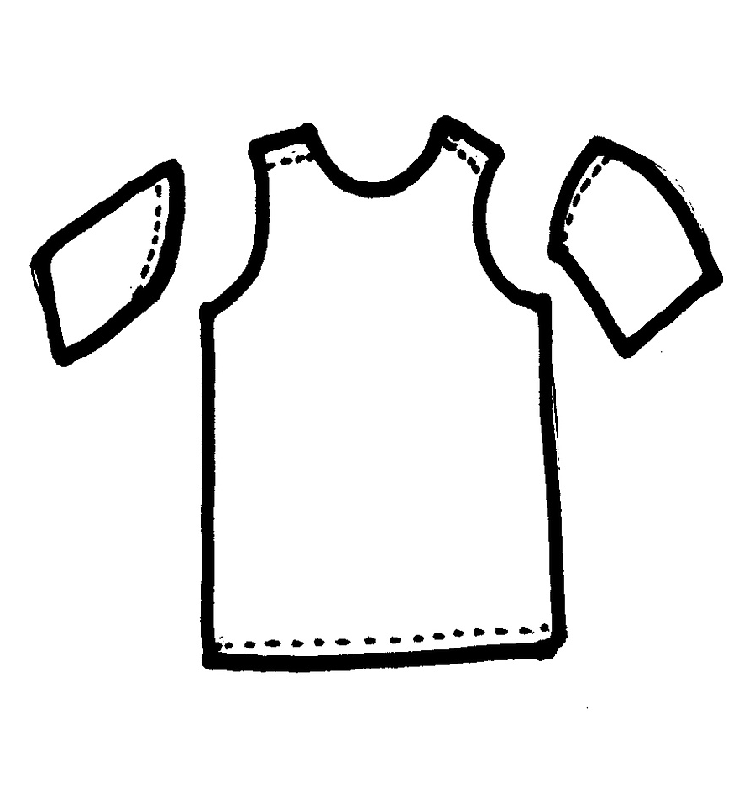
Make a TOTe Bag
1) Make into a tank
Tip: fold shirt in half hotdog style and cut both sleeves at once
2) Two most common ways to close the bottom:
a. turn inside out and sew across bottom
b. cut 3-4 inch vertical lines from bottom hem and tie pairs together, then tie again, w/ pairings offset by one
Tip: You can turn inside out or not, for different looks

Slide 13
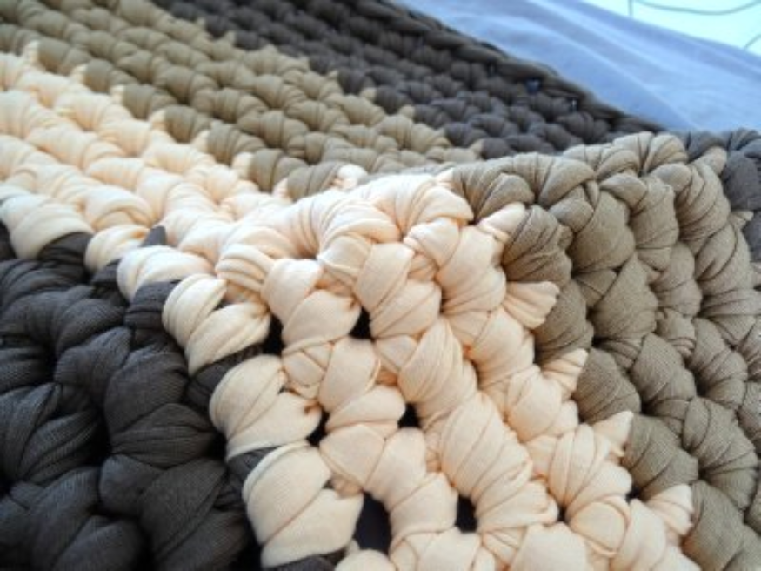
T-shirt Yarn
Difficulty: Easy but takes longer
15-25 minutes per shirt if using a rotary cutter

Slide 14
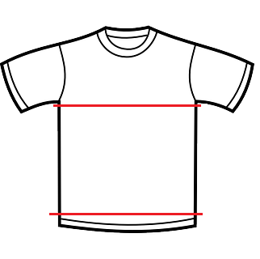
T-shirt Yarn
1) Mostly uses the torso part of the shirt Best if there are no side seams!!
There are ways to join strips of “yarn” but the best way is to cut in a spiral so you get a continuous length.
Tip if using scissors: use a guide that is easy to use while you eyeball the width that you are cutting (e.g. your thumb up to the first or second knuckle).
Difficulty: Easy but takes longer
15-25 minutes per shirt if using a rotary cutter

Slide 15
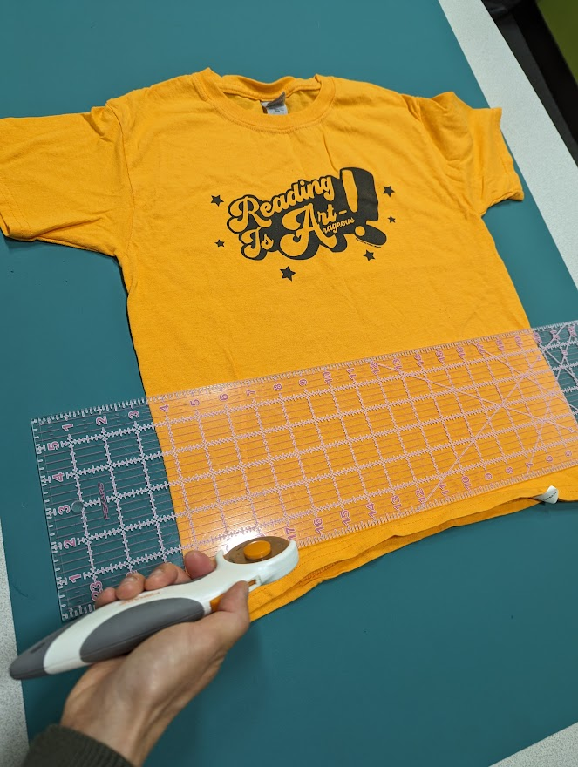
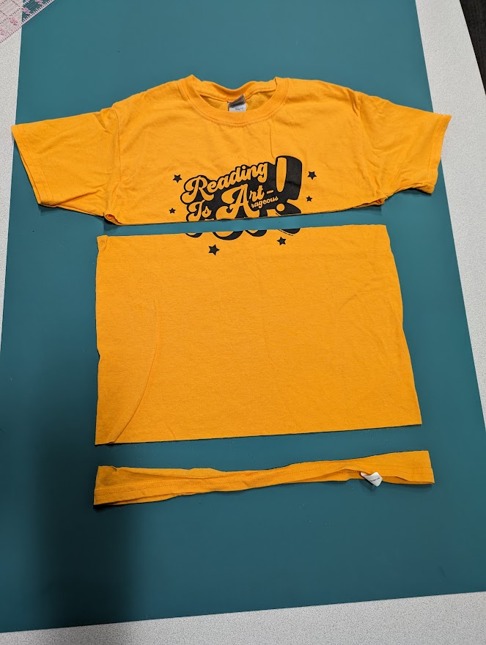

Slide 16
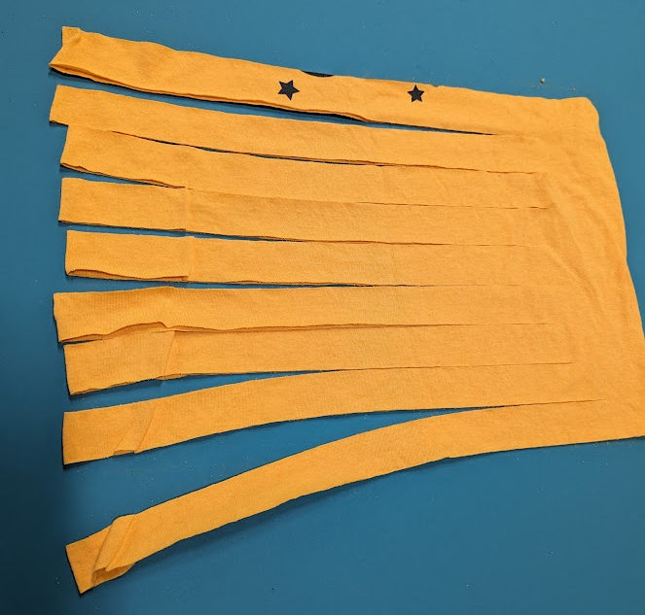
T-shirt Yarn
2) If using a rotary cutter, cut strips that go almost all the way to the other side of the shirt, but leave a few inches connected.

Slide 17
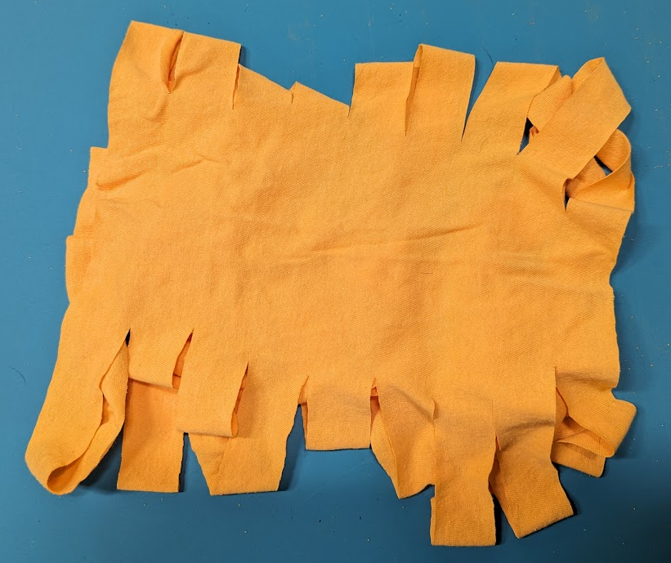
T-shirt Yarn
2) In the uncut section, use scissors to connect the cuts across, but offset by one (to make a spiral). The first and last cuts will go off the edge of the shirt, in the direction of the spiral.

Slide 18
T-shirt Yarn
2) In the uncut section, use scissors to connect the cuts across, but offset by one (to make a spiral). The first and last cuts will go off the edge of the shirt, in the direction of the spiral.

Slide 19
T-shirt Yarn
2) In the uncut section, use scissors to connect the cuts across, but offset by one (to make a spiral). The first and last cuts will go off the edge of the shirt, in the direction of the spiral.

Slide 20
T-shirt Yarn
2) In the uncut section, use scissors to connect the cuts across, but offset by one (to make a spiral). The first and last cuts will go off the edge of the shirt, in the direction of the spiral.

Slide 21
T-shirt Yarn
2) In the uncut section, use scissors to connect the cuts across, but offset by one (to make a spiral). The first and last cuts will go off the edge of the shirt, in the direction of the spiral.

Slide 22
T-shirt Yarn
2) In the uncut section, use scissors to connect the cuts across, but offset by one (to make a spiral). The first and last cuts will go off the edge of the shirt, in the direction of the spiral.

Slide 23
T-shirt Yarn
2) In the uncut section, use scissors to connect the cuts across, but offset by one (to make a spiral). The first and last cuts will go off the edge of the shirt, in the direction of the spiral.

Slide 24
T-shirt Yarn
2) In the uncut section, use scissors to connect the cuts across, but offset by one (to make a spiral). The first and last cuts will go off the edge of the shirt, in the direction of the spiral.

Slide 25
T-shirt Yarn
2) In the uncut section, use scissors to connect the cuts across, but offset by one (to make a spiral). The first and last cuts will go off the edge of the shirt, in the direction of the spiral.

Slide 26
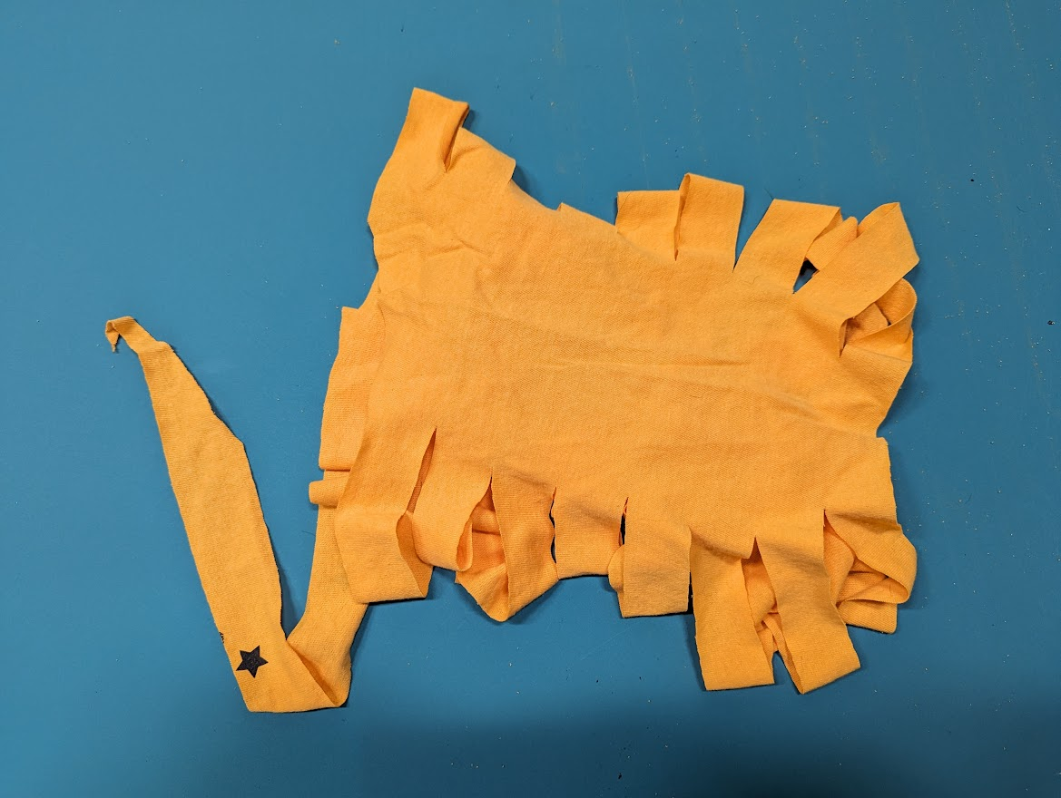
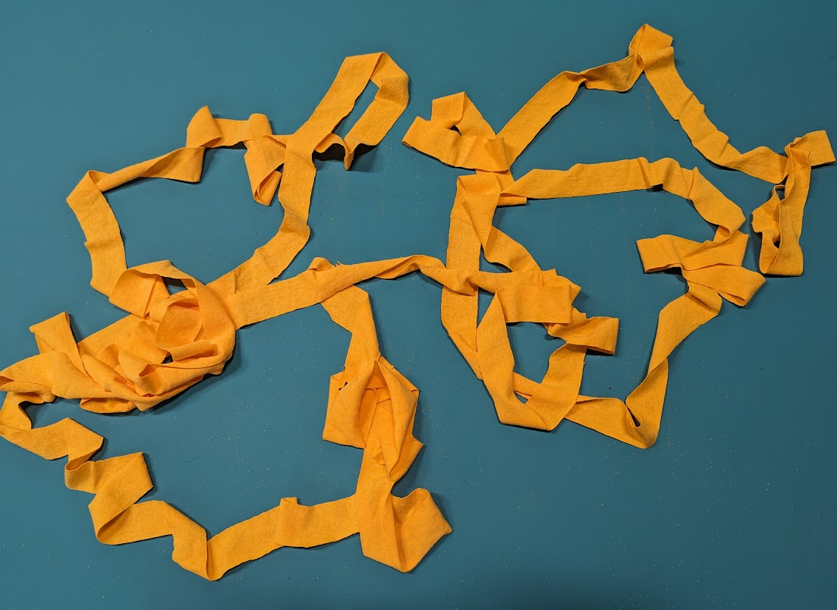
T-shirt Yarn
2) Once you have a flat ribbon, you’ll start at one end and pull the fabric so the sides roll up and you get a long “yarn” *If your strips are thin, DO NOT pull too hard!

Slide 27
Make a Top
Neckline (V, crew, halter, tube, princess, boat, laced)
Hemlines (asymmetrical, scallop, frill, fringe, straight/in tact)
Sleeves or no sleeves (frilly, shoulder hole, one sided, tank/muscle tank, ties)
Side, front, or back embellishments (slits, lacing, tying knots, beads, flowers, etc)
More possibilities (waistband/tie, v-wrap, holes/fringes)
Difficulty: Depends.
Time: Depends.
possibly anywhere between 3-30 minutes

Slide 28
Make a Top – two easy techniques
Lacing
Use a long thread of t-shirt yarn
Cut small slits (tiny, no more than a quarter inch is needed), aligned in pairs along the two sides being laced
Start threading yarn into the first pair of holes (starting at the top)
Criss-cross

Slide 29
Make a Top – two easy techniques
Lacing
Tying
Use a long thread of t-shirt yarn
Cut small slits (tiny, no more than a quarter inch is needed), aligned in pairs along the two sides being laced
Start threading yarn into the first pair of holes (starting at the top)
Criss-cross
Same as tote bag bottom:
On the side you’re tying together, cut parallel lines about 3-4 inches long and each about 1 inch apart. These are perpendicular to the open raw edge you’re tying together
Double knot matching pairs together. To make stronger, tie again, w/ pairings offset by one

Slide 30
HAVE FUN!

Slide 31
Sources
https://www.npr.org/2021/05/06/993821945/goodwill-doesnt-want-your-broken-toaster
https://remake.world/stories/news/what-happens-to-the-clothing-goodwill-cant-resell/
https://www.seattletimes.com/pacific-nw-magazine/heres-what-goodwill-really-does-with-the-stuff-you-donate/
https://www.huffpost.com/entry/what-does-goodwill-do-with-your-clothes_n_57e06b96e4b0071a6e092352

